Slide 1
California Housing Price Prediction
2018 by SHEIK

Slide 2
Agenda
Objective
Data Visualization
Data Preprocessing and cleaning data
ML Model built and validation
Test set Prediction and measuring accuracy with metric RMSE [Root Mean Squared Error]

Slide 3
Objective
The purpose of the project is to predict median house values in Californian districts, given many features from these districts.
The project also aims at building a model of housing prices in California using the California census data. The data has metrics such as the population, median income, median housing price, and so on for each block group in California. This model should learn from the data and be able to predict the median housing price in any district, given all the other metrics.

Slide 4
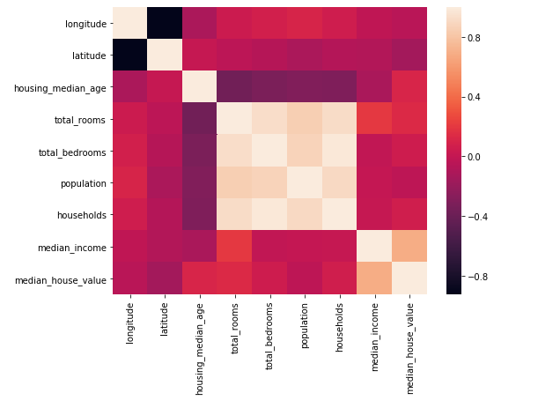
Data Visualization
Dataset has 20640 records and 10 features.
Correlation heatmap shows relationship among all features.

Slide 5
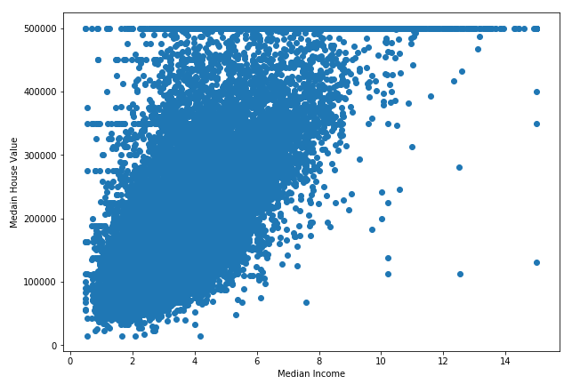
Data Visualization
Scatter plot of Median Income vs Median house value.

Slide 6
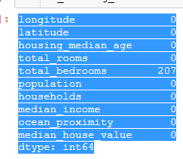
Data Preprocessing and cleaning data
Missing values count:
Imputed total bedrooms missing data with mean.

Slide 7
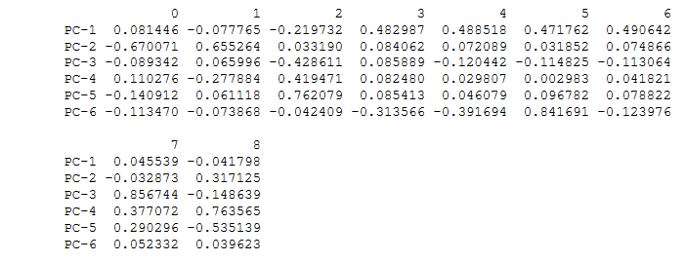
Data Preprocessing and cleaning data
PCA: Dump components relations with features: This gives us the picture of how features are related to components

Slide 8
Model Building and Evaluation
ML Model Used | Test Set Accuracy | RMSE
Linear regression | 53.5% | 79072
Decision Trees | 63.4% | 70152
Random Forest | 74% | 59055

Slide 9
Thank You

